Slide 1
Click-Through Rate Prediction
By Jeff Gross

Slide 2
Steps
Load data
Exploratory Data Analysis
Pre-Processing
Data Prep
Models
Result

Slide 3
Load Train Data
Problem:
Data set is too big (40,428,967 rows)!
Options:
Chunks
Load first n lines
Problem:
result is not a small randomized sample of the data
Solution: Use the skiprows or random selection
Chose skip rows (skip 1 row every 10 rows)
Chose this method since the data since this data set is already ordered by time of event occurrence and thus such sampling will result in a representative sample.

Slide 4
Test data set was small enough to load directly & in its entirety
Load Test Data (Holdout)

Slide 5
Exploratory Data Analysis
EDA for missing values
Result: no missing values in the data set

Slide 6
Features keep/remove
Assessed the number of unique values that the feature has
Determine if the feature has too many unique values or not
The following features were kept & unique values <1% were collapsed in an other group
Banner_pos
Site_category
App_category
Device_type
Device_conn_type
Site_id
Site_domain
App_id
App_domain
Device_id (dropped)
Device_ip (dropped)
Device_model
C1
C14:C21

Slide 7
Dummy Variables
Created dummy variables for the following variables:
banner_pos
site_category
app_category
device_type
device_conn_type
site_id
site_domain
app_id
device_model
app_domain
C1
C14:C21

Slide 8
Train/test split
Randomly split “train” set into 20% train & 80% test

Slide 9
Scaling
Two options:
Standardize
Normalize
Preferred to standardize
when you standardize, the test data can have samples that fall outside the normal range

Slide 10
Machine learning techniques
Logistic Regression
01
Decision Tree Classifier
02
Random Forest Classifier
03
XGBoost
04

Slide 11
Evaluation technique
Accuracy
Potential problem with “accuracy paradox”
Other options precision, recall, F1 score
Optimal for classifier: AUC
The ROC curve represents how the classifier is performing.
The x-axis is the false positive rate and the y-axis is the true positive rate or recall.
The area under the curve is the percentage of tradeoff between sensitivity (true positives) and specificity (1-false positives).

Slide 12
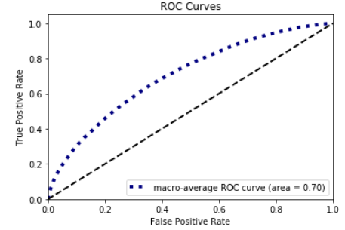
Machine learning-logistic regression
Accuracy = .83
Area Under the Curve = .70

Slide 13
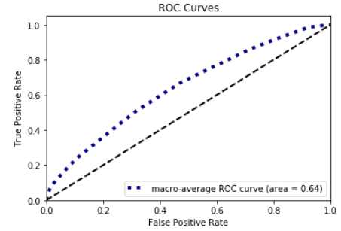
Machine learning-Decision Tree
Accuracy=.83
AUC=.64

Slide 14
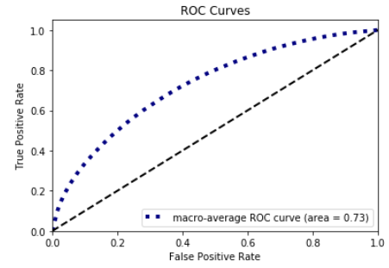
Machine learning-Random Forest
Accuracy=.83
AUC=.73

Slide 15
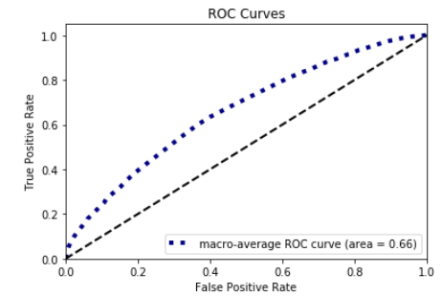
Machine learning-XGBoost
Accuracy=.83
AUC=.66

Slide 16
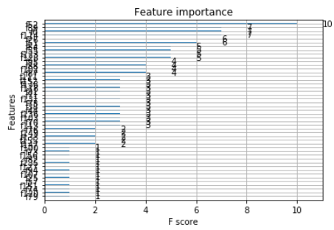
Most Important Features-Part 1

Slide 17
Most Important features: using XGBoost
1. C18_2=‘2’
2. dct_3: device conn type=‘3’
3. C1_1=‘1002’
4. s_id_2=site id= ‘e151e245’
5. C16_99: Other

Slide 18
Results
Model | Logistic Regression | Decision Tree | Random Forest Classifier | XGBoost
Accuracy | .83 | .83 | .83 | .83
AUC | .70 | .64 | .73 | .66

Slide 19
Conclusion
Best machine learning technique based on AUC after pre-processing, train/test split & normalization:
Random Forest Classifier

Slide 20
What to do next?
Apply time series analysis to the data
Apply deep learning (recurrent neural network)
With access to parallel computing, I could perform the analysis and especially apply the machine learning with all the data
Utilize fine tuning (GridSearch/Random GridSearch) to the machine learning to improve AUC
Use the feature importance from XGBoost and/or Backward Elimination to be more selective in feature selection and build the optimal model with the aim of improving AUC

